Slide 1
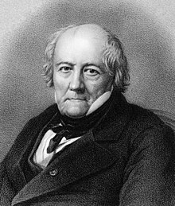
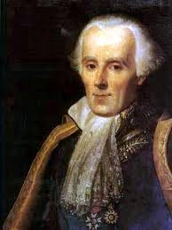
The Biot-Savart Law
Coulomb's Law relates static electric fields to the point charges which are their sources
The Biot-Savart Law relates static magnetic fields to the currents which are their sources
Finding the magnetic field resulting from a current distribution involves the vector product and is inherently a calculus problem when the distance from the steady current to the magnetic field point is continuously changing
Jean-Baptiste Biot
1774-1862
Félix Savart
1791-1841

Slide 2
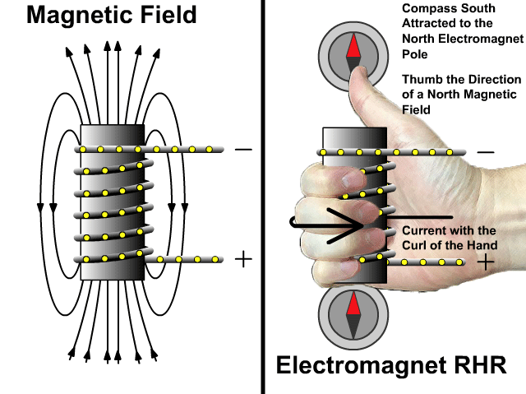
How Electromagnets Work

Slide 3
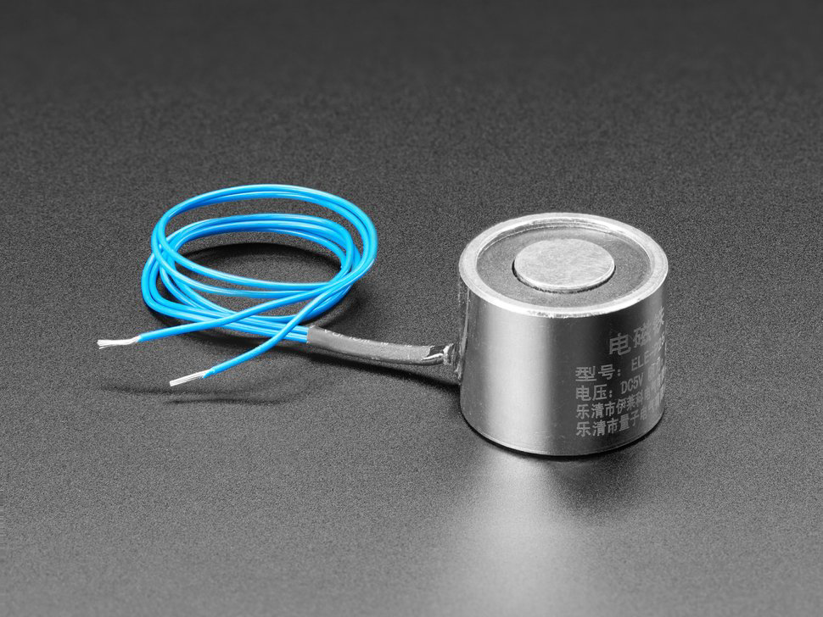
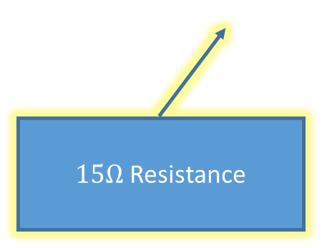
$15Ω$ Resistance

Slide 4
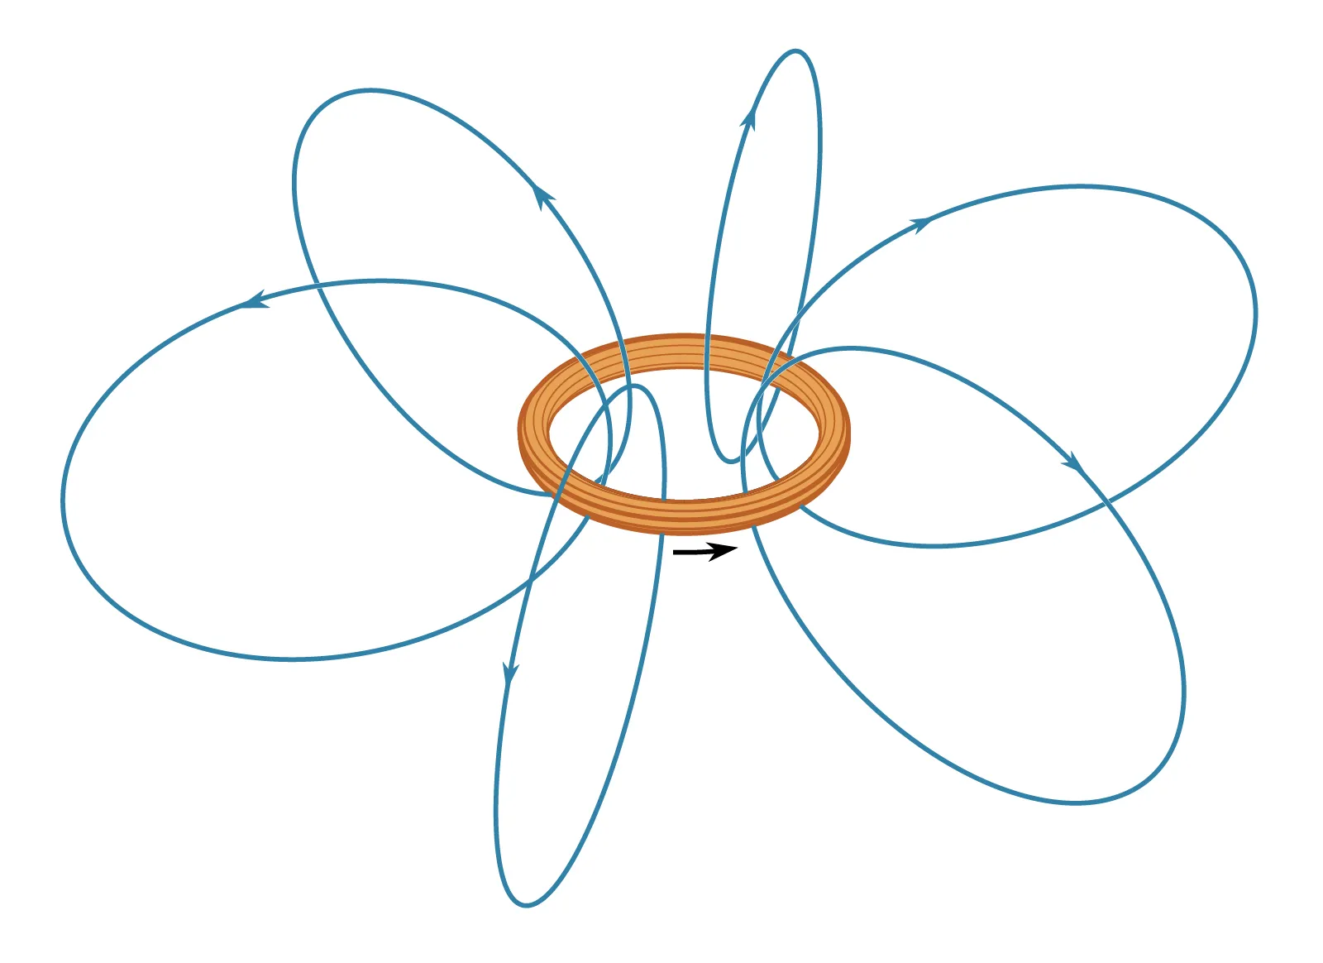
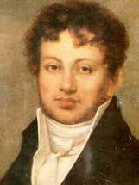
The Biot-Savart Law
Magnetic Field Lines
I
André Ampère
(1775 – 1836)
Moving charges (a current) produce a magnetic field

Slide 5
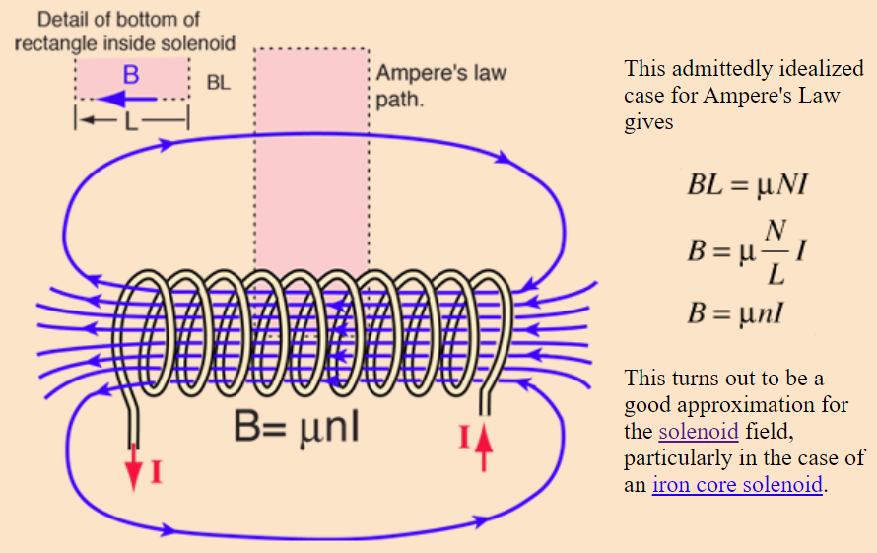


The Biot-Savart Law
$$μ=k×μ_{0}$$
n is # of turns per unit length
(turn "density")
$k$ = relative permeability of the solenoid core

Slide 6
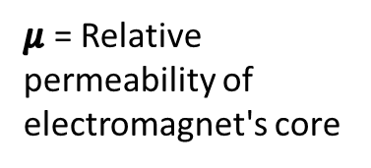


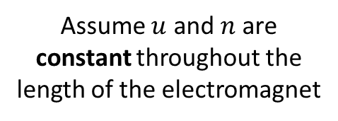
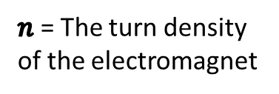
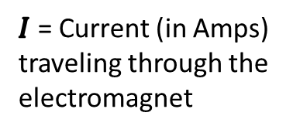
The Biot-Savart Law
$μ$ = Relative permeability of electromagnet's core
$$B=μ×n×I$$
Assume $u$ and $n$ are constant throughout the length of the electromagnet
$I$ = Current (in Amps) traveling through the electromagnet
$n$ = The turn density of the electromagnet
$$y=m×x$$
As we increase current (I) flowing through the electromagnet, the magnetic field strength (B) of the electromagnet should rise at a linear rate

Slide 7
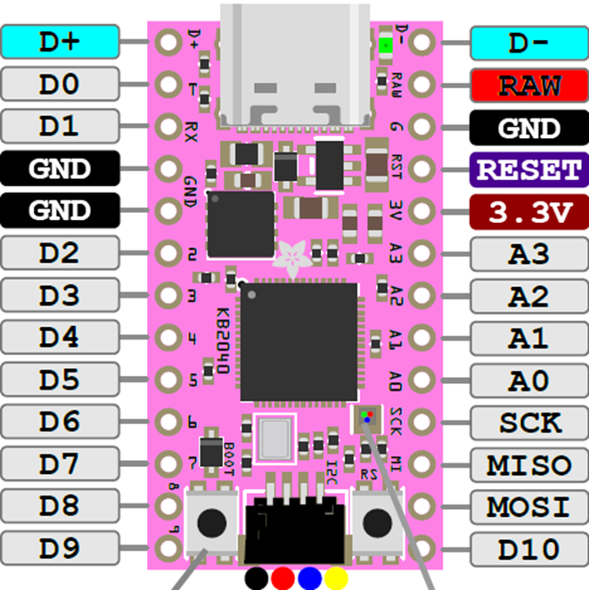
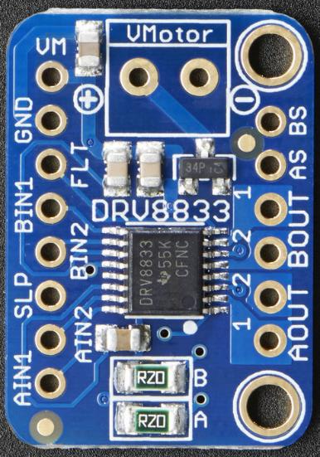

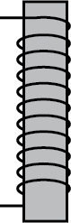
Why We Need a Motor Driver
1KΩ
The KB2040 can kill the power to the electromagnet by putting the DRV8333 into sleep mode by asserting the SLP pin (D6 on MCU)
The KB2040 can set the output voltage of the DRV8833 using pulse width modulation (PWM) on pins D7 and D8

Slide 8
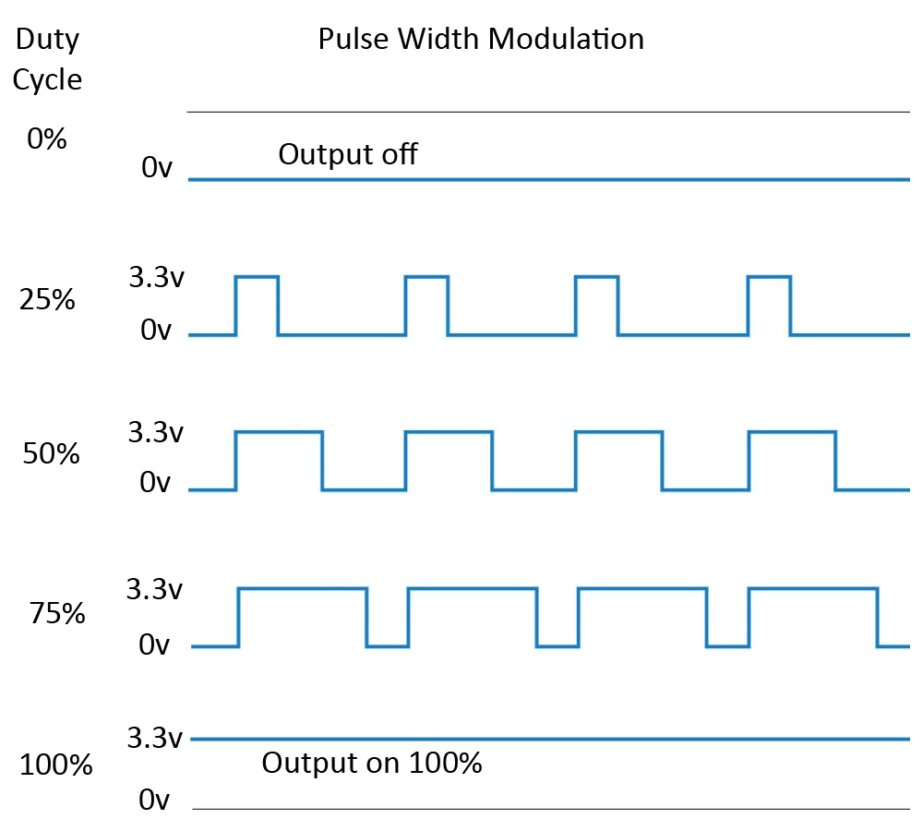





Digital to Analog Conversion via PWM
$$0V$$
$$3.3×0.25=0.825V$$
$$3.3×0.50=1.65V$$
$$3.3×0.75=2.48V$$
$$3.3V$$

Slide 9
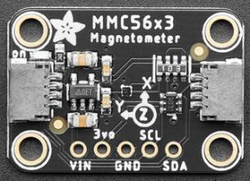
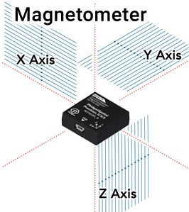

Triple Axis Magnetometer
Because the magnetic fields at the end of the electromagnet are circulating in all three dimensions in both clockwise and counterclockwise rotations, we will use this formula to find the total magnitude (strength) of the field:
$$M_{TOT}=\sqrt{{M_{x}}^{2}+{M_{y}}^{2}+{M_{z}}^{2}}$$

Slide 10
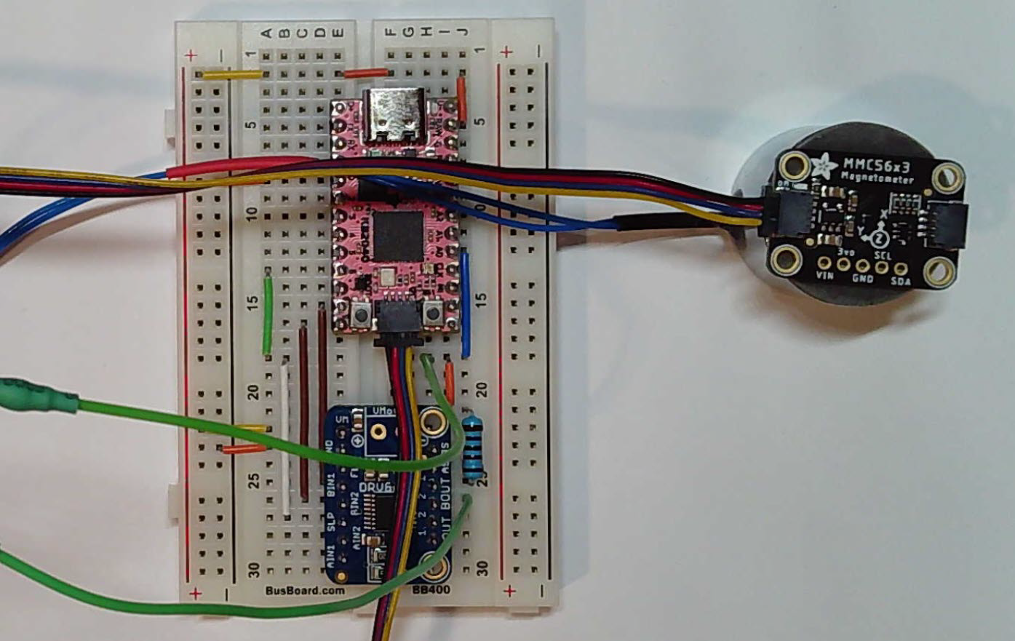
Step 44 – MMC5603 and Qwiic
(1) MMC5603
(1) 5V Electromagnet

Slide 11
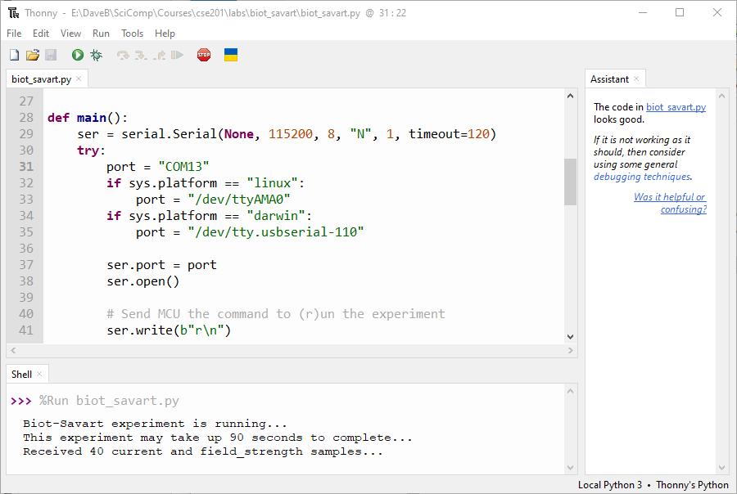
Check biot_savart.py

Slide 12
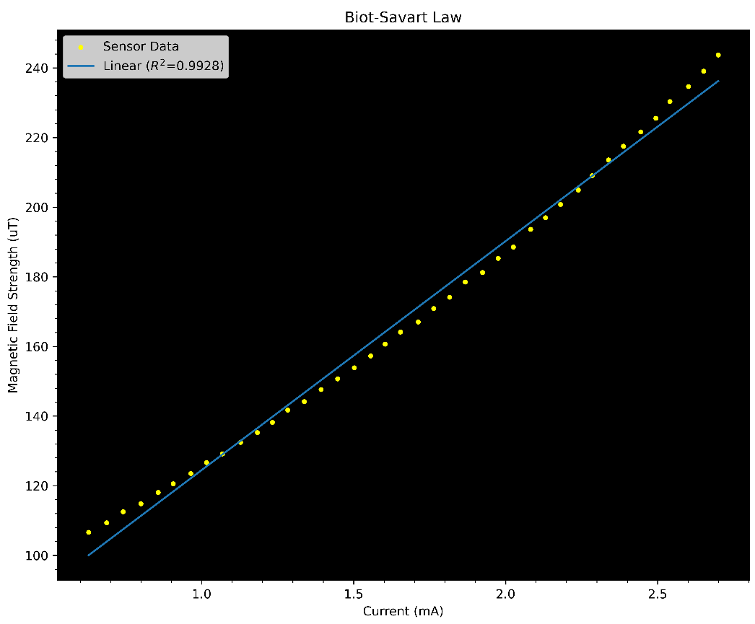
Check biot_savart.py

Slide 13

Check biot_savart.py
$$B=μ×n×I$$
constants
There appear to be some small non-linear effects – why do you think that might be happening?

